Slide 1

Technology Trend Detection using Natural Language Processing
Final Talk Master‘s Thesis
Jishnu Jayaraj
Andreas Maier¹, Nadine Ruecker¹, Thomas Kinkeldei²
1: Friedrich-Alexander-Universität Erlangen-Nürnberg 2: ROKIN Tech
Notes:
Hello before I begin, I hope everyone can hear my voice and see the slides. Okey
Gud afternoon lambda, my name is Jishnu, and I will be presenting final talk on master thesis.
It was done in collaboration with ROKIN, a munich based startup whose goal is to
supports industrial companies in identifying new and relevant technologies tailored uniquely for each companies.
My work is on Tech trend det usin NLP : I guess NLP is a exotic topic in our colloquim. But nevertheless I hope everyone enjoys this novelty.
I would also like to Thank Nadne and Thomas who stood by me throughout the entire process.

Slide 2
Outline
Introduction
Motivation
Objective
Challenges
Methodology and Methods used
Result & Discussion
Conclusion and Future work
Notes:
This is the general outline of the presentation.
First section provides motivation for this thesis, then the objective of the work is discussed. The challenges in making such a framework are also addressed at the end.
Next section provides framework architecture that can resolve above mentioned challenges with detailed description of each methods.
The result of the framework is presented and evaluated in next section.
The final section discusses the limitations of current work with possible future works.

Slide 3
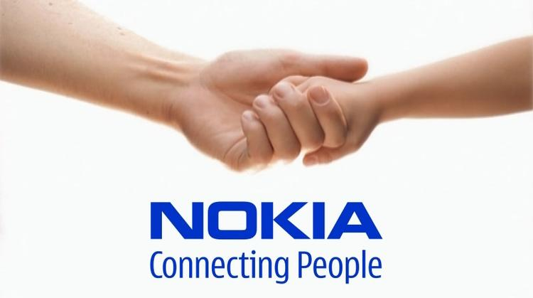
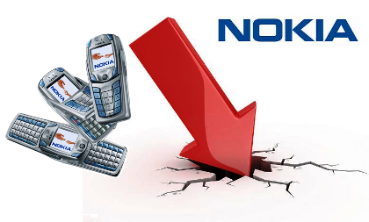
Motivation
Company success
Potential opportunity of new technologies
Adaptation to population changes
NOKIA failed to stay up-to-date with changing market.
Could have been avoided by analyzing market and predicting future trends.
Notes:
..…We all know the mobile brand NOKIA, company was market leader for decades with its original touchpad phones, if you remember…… but …… in 2021 if you look around this brand is pretty much non-existant.
Why u may ask, its bCoz NOKIA lacked foresight in market change
…..For successful operation of a company it needed to embrace new techn and adapt to changing market topology.
…..In NOKIAs’ case it was late to embrace touch screen phones and software that focus user experience.
Competitors like IOS has given customers 1s t touch screen phones which was soon followed by android, and but by the time nokia embraced this new technology the market was already captured by its competitors.
….. This could have been avoided if they were able to identify trends and stayed competitive in market. This shows how crucial trend detection is for every company.

Slide 4
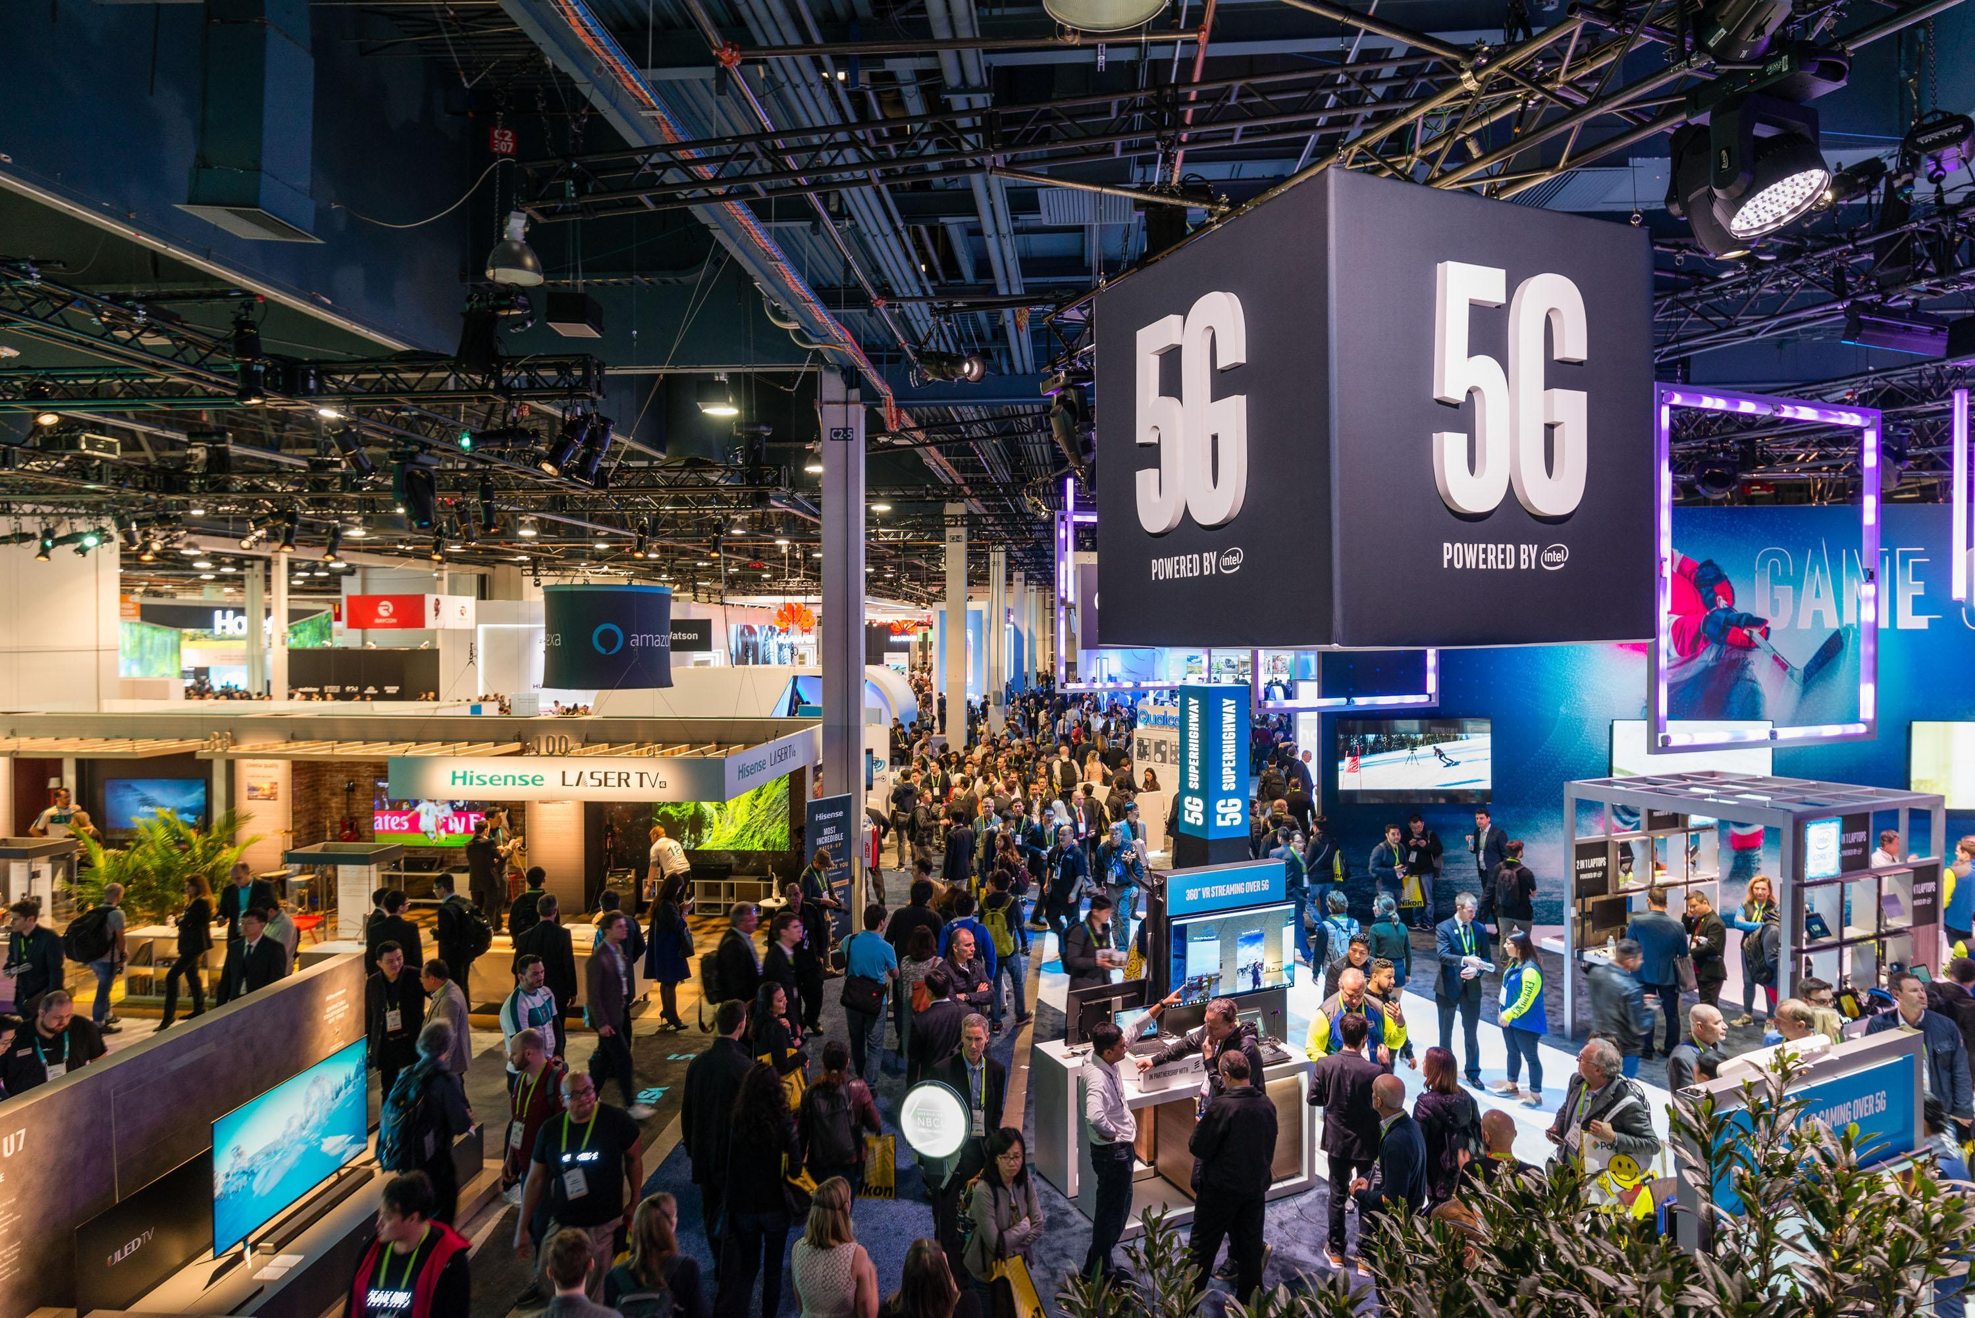

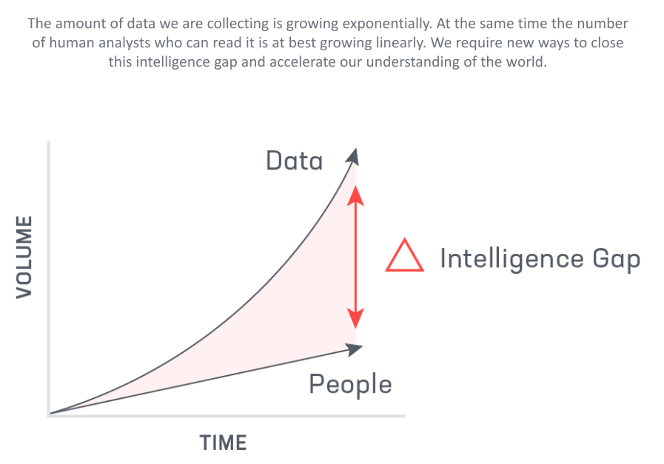
Objective
Automatic identification of relevant technologies trend from database of news articles.
Notes:
So we know trend detection is essential, but to anlyze trends we need data.
This data can be acquired from various sources like …..trade shows/messe and from plethora of …….news journals available online
This wide range of data sources creates a problem:….. The exponential growth of data
data produced each day or to say hour is so large that it’s impossible for a single human to catch up with it.
….. So objective of this thesis is to minimize this intelligence gap between people and data by automatically identifing trends from a large news dataset.

Slide 5
Challenges
How to compare different articles in order to find semantically similar ones?
How to group articles to separate topics?
How to choose the most representative trend from grouped topics?
Notes:
detecting trend from large corpus of text data comes with some Major challenges :
….. Firstly, How do we compare different articels with each other
….. 2ly, How can we group articels based on latent topics in them
….. How to extract Trend/keyphrase from these articles
These are the qustions that a successful trend detection alg should answer.
===============
Research question

Slide 6
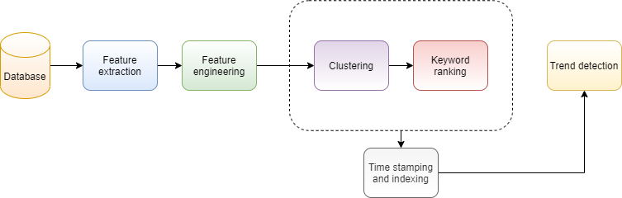
Methodology
Notes:
This slides shows how I tackled the challenges discussed before and the methods I used to solve those challenges.
…..Figure shows the framework used to analyze trend.
Data from database is transformed into numerical form by feature extraction - The extracted features are enriched using feature engineering method– these enriched features are then fed to clustering alg to group articles based on topics – from this grouped cluster of articels keyphrase/trends are extracted.
Result from clustering and Keyword ranking are stored as meta data along with articles and then transformed to time series data by aggregating articles to a fixed size time interval.(essentially a binning process so to say, ie transforming continious data to equaly sized discrete values)
This information enables user to give queries that can detect and track trends from data.
=====
DF is created with date and title. Appended with cluster inf. Then a custom date (upper and lower) selected by user. This articels are converted to time series by binning and aggregating. A multi indexed DF with date. This DF is used for keyword extraction and temporal analysis.
Left: text-> numeric, middle clustern n trend, end joining – track trend
---
by binnig all dates to a interval

Slide 7
Database: exploration
Database
Feature extraction
Feature engineering
Clustering
Keyword extraction
News articles from various online news publications are stored in ROKIN database (6+ million articles).
Filtered to a subset of total sample size of 5874 articles from 2019.
TITLE | DATE
MicroLED display optimizes AR viewing | 2020-04-01
Why language technology can’t handle Game of Thrones | 2019-04-18
Material Chemists Demonstrate Potential to Produce Sustainable Fabrics from Fungi | 2020-06-08
3D Hubs opens $1000 3D Printing Student Grant | 2019-03-01
Notes:
Ribbon on top consolidates the pipeline of framework discussed in prev slide. And we begin with data exploration
…..The ROKIN database has over 6 million+ articles just in 2019 crawled from various web pages.
Since it’s a unsupervised problem, Large data makes it hard to evaluate the quality of results and also its impractical to interpret graphs
….. So for illustration purpose only a subset of dataset was taken. For this a toy dataset was made by randomly sampling 2 percent of data from each month starting from Jan2019 to oct 2020.
Some randomly sampled data from this toy dataset is illustrated in Figure….. It contains tech news from various domains, like from solar panels to even space mission topics
Even though multiple feature were available like title, body or full text of articles, its url, date, id etc, but for our task, features used are only title and date. Because title is expected to have the trending phrase within them while also while having less noise compared to full article text. However this sacrifices some information from artiles but provides higher quality text and less computational time.
(1) How to Make Your Powerpoint Tables Look Sexy – YouTube

Slide 8
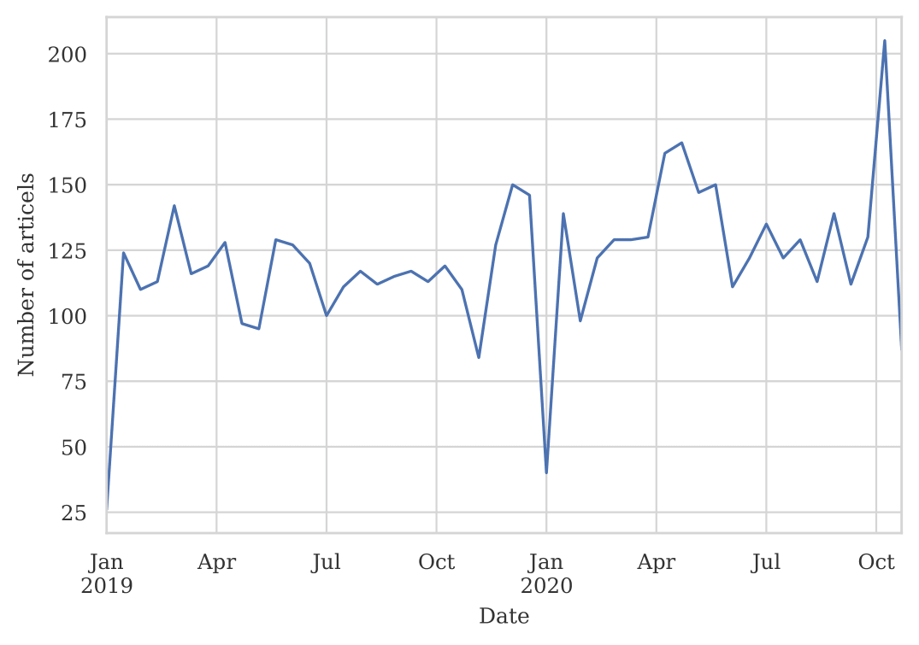
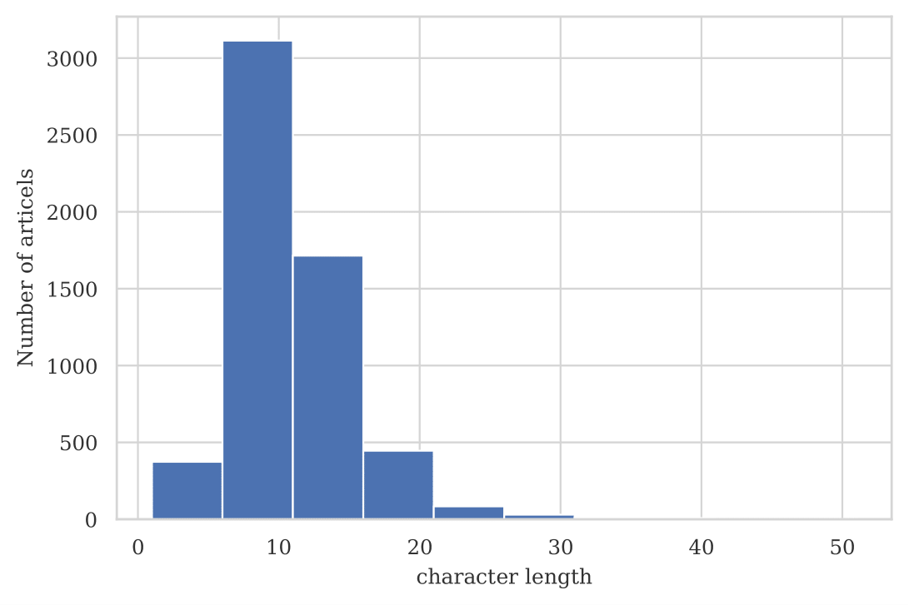
Database
Feature extraction
Feature engineering
Clustering
Keyword extraction
Database: statistics
Amount of articles produces through out the year
Distribution of word count of ‘title’ for articles
Notes:
This slideshows the statistical properties of data.
Fig 1…..shows num of Articels published with respective dates. In average, each month correspond to about 600 articels. You can see the gradual increase in volume of digital data being produced. And interesting fact is there is a dip in amount of data produced during Christmas-new-years vacation time.
Next Figure….. shows distribution of length of article title. So the Avg word length for articels are 5-15 words. Though there are few outlier goes beyond 30.

Slide 9
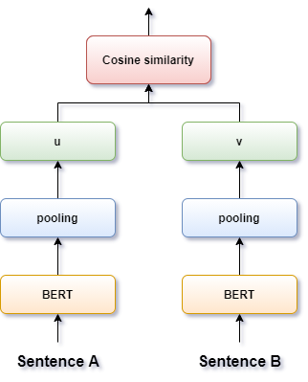
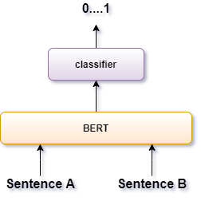
Feature extraction: model
Data exploration
Feature extraction
Feature engineering
Clustering
Keyword extraction
Model architecture: Transformer¹ (attention based)
Model: BERT² (Bidirectional Encoder Representations from Transformers)
Model capable of differentiating Semantic similarity
+ accurate
- slower
+ faster
- require large training data
Cross-encoder
Bi-encoder
Training: SBERT³ (Sentence BERT from UKP-Lab)
Notes:
So the 1st task is to convert text to numerical form for comparison and computations, There are various encoder-decoder configurations also called seq2seq models that is capable of doing it.
…..Transformer models are one such a seq2seq model that is optimized with attention mechanism. The Attention mechanism allows the model to refer back to input seq and concentrate on relevant information rather than whole input sequence. These transformer models are similar to the ones used in CV and are able to produce SOTA performance in various NLP tasks.
…..One such transformer based pre-trained model for NLP is BERT from researchers at Google. It uses a bidirectional encoder, enabling it to analyze sentence left-right and right-left.
BERT was pre trained on Wikipedia and google books for general purpose language understanding. And is able to produce accurate representations of words and sentences.
……But in our case, we should be able to compare articles based on semantic similarity, hense pre-trained BERT model should be fine tuned to produce better result in sentence similarity task. …..Traditional BERT uses a cross encoder architecture for evaluating sentence similarity. Thus requiring both seq/sentences to be fed simultaneously with corresponding labels for training. Since it separately compares all possible combination of articles, it has high computational complexity in order of o(N2), where N is num of seq
…..So author Reimers, came up with tweaked version of BERT called SBERT for scoring sentence similarity SBERT which uses a biencoder/Siamese architecture for training
…..Idea is to pre-compute embeddings for each sequence in the dataset separatly from all other sequences and then use these embeddings in a second step to measure, similarity with any similarity metric say eg: cosine.
Both has its pros and cons ,…..the cross encoders are accurate but slower.
While bi encoders require substantial training data and fine-tuning over the target task to achieve competitive performances.
========
Pre trained models are trained on a book corpus and Wikipedia articles for multiple general tasks like MLM (masked language model) and NSP (next sentence prediction).
mean aggregation as pooling layer, max_seq_length = 128 and train_batch_size = 64 default values from Reimers model

Slide 10
Feature extraction: Fine tuning
Data exploration
Feature extraction
Feature engineering
Clustering
Keyword extraction
Augmented SBERT¹
Data augmentation technique, where high performant cross-encoder are used to label dataset for bi-encoder training
Dataset used :STSb dataset
Fine-tune cross-encoder (BERT) on gold STSb dataset
Fine-tuned Cross-encoder is used to label on Semantic Search sampled unlabeled pairs (silver STSb dataset)
Bi-encoder (SBERT) is finally fine-tuned on both gold + silver STSb dataset
Model outcome
Vector embeddings
Distance corelates to semantic difference
Notes:
But as we have discussed in prev slide each BERT architecture has its pros and cons,
….. Author Thakur has described an effective data augmentation strategy using both cross and bi-encoders in his paper AugsBERT. So basically what it does is
He utilize a high performing and slow cross-encoder (BERT) to label a larger set of input pairs, to augment the training data, for the bi-encoder (SBERT)
Before going to Fine tuning we must have a labeled dataset for sentence similarity.
…..The freely available dataset for sentence similarity in news articles which I was able to find is the STSB dataset.
STSB contains pair of sentence from various forum post and news with corresponding similarity score. This dataset is fed to AugsBERT pipeline to fine-tune the bi-encoder model.
The idea described in AugsBERT is , ……STSB dataset is the Gold data which is used to train cross encoder
….. The sentences are then recombined and sampled to create silver dataset labeled using cross encoder
….. Bi-encoder model is then trained on this gold and silver dataset with cosine similarity loss
This fine tuned bi encoder model is then fed with article from ROKIN dataset
…… create vector embeddings of each articels. This vectors will generate a semantic vector space for our article database.
…..In this semantic space, the distance among vectors represents the semantic similarity between the articles.
So that similar articles will be embedded close together
=====
Semantic Search sampling using pretrained SBERT model for retrieving to pk
For every sentence in gold , a sentence is taken and top 3 was selected from list
CosineSimilarityLoss: It is thus a judgment of orientation and not magnitude
---

Slide 11
Feature engineering
Data exploration
Feature extraction
Feature engineering
Clustering
Keyword extraction
Output embedding size: 512 dimensional vector
Curse of dimensionality: computational cost and sparce distribution of vectors
Dimensionality Reduction: UMAP¹
Better performant than PCA and TSNE¹
Best performing and maintains local and global structure of embeddings simultaneously
Parameters
output dimension = 5
neighborhood points = 15
min distance = 0.01
Notes:
…..The dimensionality of vectors produced from our model is of size 512.
…..Which result in high dim problems such as ,sparce space of embeddings(difficult to cluster), and high computational cost for processing.
…..Hence UMAP dimensionality reduction was applied on theses embeddings.
UMAP is a novel manifold learning technique for dimension reduction.
It is constructed from a theoretical framework based in Riemannian geometry and graph topology
…..The adv of umap is
- According to author its faster and produces better embeddings than PCA and TSNE
- Ability to maintain local and global structure of embeddings after dimenionality reduction. Which can help to retrieve the embedding integrity in the database
….. The dimension is reduced to 5 and manifold was created using 15 neighborhood points. And in order to prevent tight packing a min distance of 0.01 was also given
=======
Manifold can handle non-linear relation in data.
Tsne also ,amifold, but scalability issue(also plain grad descent and stochastic gradient desent)
(only local vs global structure preservance)

Slide 12
Clustering
Data exploration
Feature extraction
Feature engineering
Clustering
Keyword extraction
Densely packed embeddings → articles with common topic
Density based clustering :HDBSCAN¹
Ability to classify outliers as noise
Ability to cluster arbitrary shapes
Unsupervised, doesn’t require number of cluster
parameters
min cluster size = 25
min sample = 12
cluster epsilon = 0.3
Notes:
…..In the new reduced dimension, a dense cluster of vectors correspond to articles with similar topic. So high density of points corresponds to higher probability of underlying topic.
So based on this assumptions, density based clustering algorithm is used for extracting clusters.
…..HDBSCAN is one such algorithm that find local cluster of dense area.
(Heirachical clustering alg using min spanning tree to maximize stability of cluster)
…..It provides several pros to our particular problem: -ability to classify noise, can cluster varying density cluster, and most importantly a unsupervised method that does not require num of clusters in advance
…..For ROKIN toy dataset, the min num of articles required to consider itself has cluster was set to 25 and 12 nearest neighborhood points were used for estimating the pdf of distribution. With distance threshold of cluster was set to 0.3
==========
Transform the space according to the density/sparsity. (Weighted graph using mutual reachability distance)
Build the minimum spanning tree of the distance weighted graph.
Construct a cluster hierarchy of connected components.
Condense the cluster hierarchy based on minimum cluster size.
Extract the stable clusters from the condensed tree.
It extends DBSCAN by converting it into a hierarchical clustering algorithm, and then using a technique to extract a flat clustering based in the stability of clusters. allow varying density clusters.

Slide 13
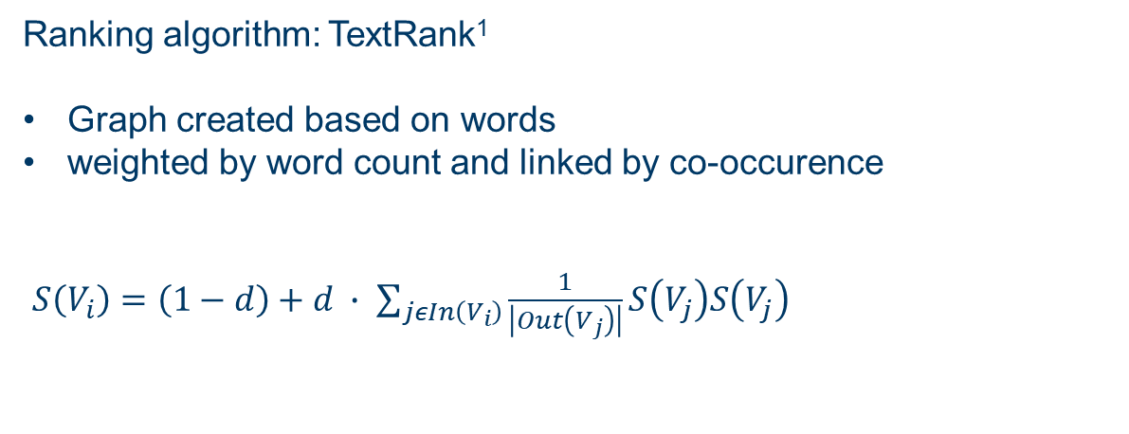
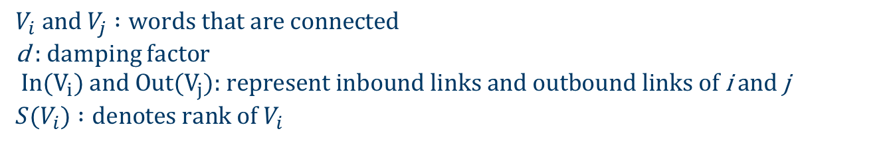
Keyword extraction
Data exploration
Feature extraction
Feature engineering
Clustering
Keyword extraction
Ranking algorithm: TextRank¹
Graph created based on words
weighted by word count and linked by co-occurence
$S\left(V_{i}\right)=\left(1−d\right)+d ∙ \sum_{jεIn\left(V_{i}\right)}{\frac{1}{\left|Out\left(V_{j}\right)\right|}S\left(V_{j}\right)S\left(V_{j}\right)}$
$$V_{i} \text{and}{ V}_{j} :\text{words} \text{that} \text{are} \text{connected}$$
d : damping factor
$$\text{In}\text{(}V_{i}\text{)} \text{and} \text{Out}\text{(}V_{j}\text{): }\text{represent} \text{inbound} \text{links} \text{and} \text{outbound} \text{links} \text{of} \text{i} \text{and} \text{j}$$
$${S(V}_{i}) :\text{denotes} \text{rank} \text{of} V_{i}$$
Notes:
After all the articles with similar topic are clustered, they need to be further condensed to keyphrases or trends that best represent the cluster.
…..For this a ranking algorithm: TextRank is used.
(its graph-based ranking model used to rank words.)
…..It works by creating a graph, based on words(no stop words) weighted by word count. Words are linked based on thier co-ocurance
The ranking alg is given by equation….
As we can see, the rank depends on number of inbound and outbound links, so higher score is given for phrase with max number of connections with other phrases, ie the common phrase.
=======
The basic idea implemented by a graph-based ranking model is that of voting or recommendation. When one vertex links to another one, it is basically casting a vote for that vertex. The higher the number of votes cast for a vertex, the higher the importance of that vertex.

Slide 14
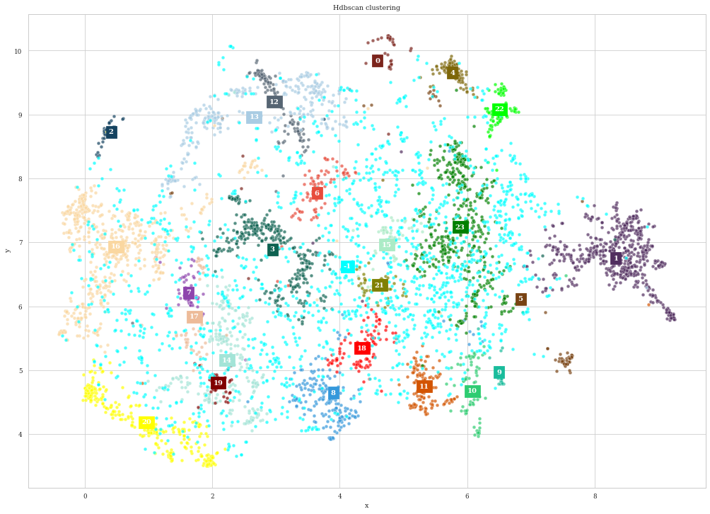
Result: Clustering
Space
Material science
Computer science
Notes:
Embedding is be Visualize by reducing it to 2d and color coding every clusters. There are 23 clusters in total and as you can see the clusters are
well distinct even in 2d .Light blue points represent noise(points that are not dense enough to be individual cluster).
Its also notable that clusters are grouped semantically. For example the bottom clusters
….. Represent computer science in general, with individual clusters corresponding to AI, computer processor, cloud and network and so on. Tho they belong to distinct clusters, they were grouped close by, by the algorithm.
…..Similarly the clusters in left correspond to material science, with individual clusters with topics quantum tech, electronics, sensors and so
……The excluded cluster in top left correspond to space topic, with topics related to NASA and spaceX.
Further analysis is done in coming slides
=======
Point in middle, artifacts by reducing dimen to 2 for visualiz.

Slide 15
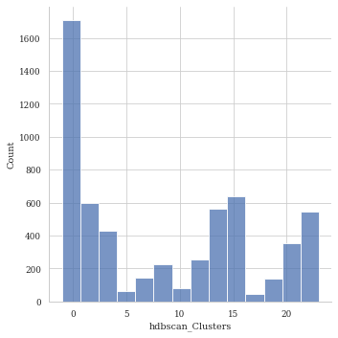
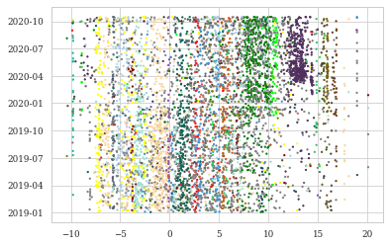
Cluster distribution
Cluster distribution
Cluster distribution with date
Notes:
This slide shows cluster distribution.
…..First image shows how many article belong to each cluster, we can see the -1 noise has highest. And most major clusters having more than 200 articles in them.
…..In figure 2 the clusters embeddings are reduced to 1d and plotted with date, to see how the distribution of clusters changes with time. We can see some topics like violet and green become prominent in 2020 compared to 2019

Slide 16
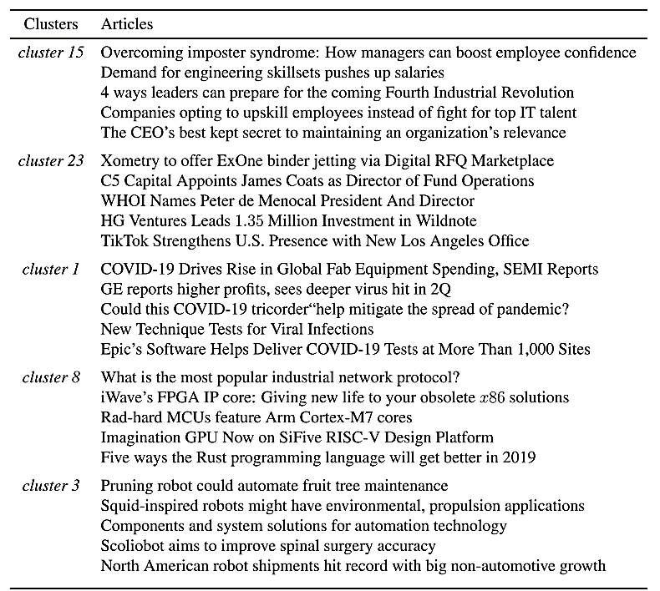
Top 5 clusters
Notes:
Now to see which were the dominant topic in the cluster, clusters with largest number of articels in them were selected. From this top clusters, 5 articles are randomly sampled and showed in table
Mostly, general topic on all articels are coherent
like
Cluster 15 is about manger-employee relation and skill and talent
- 23 talks about market and decision makers like directors and president
1 discusses on Health care and covid
8 has articles about Compute processing like FPGA, CPU cores
3 is about Robots and automation
Its also important to note there are some outlier articles, like in cluster 8 which is about computer processing, has one article is about ‘network protocol’. But mostly the clustering has done a good job in aggregating articles.

Slide 17
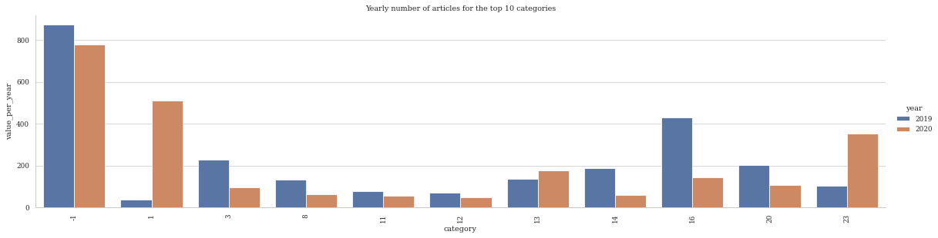
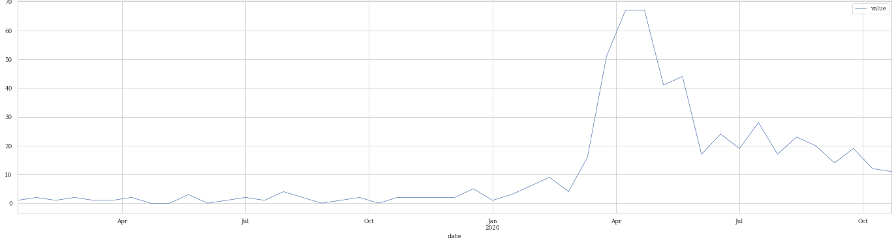
Temporal analysis of top clusters
Cluster growth with year for top10
Cluster growth with month for cluster 1
Notes:
After analyzing the top clusters and their related articles now we can analyze how cluster trendiness varies for this top clusters.
…..This figure shows top 10 clusters and their variation in trend score from 2019 to 2020.
So there are some topics that has grown in value while some has lost its trend score. But its interesting to note a huge jump for cluster 1 and a detailed anlayzis for cluster 1 shows
….. its change in trend score from dec-Jan 2020. So the cluster 1 was pretty much absent until Nov 2019 and started growing specifically in dec 2019 and jan 2020.

Slide 18
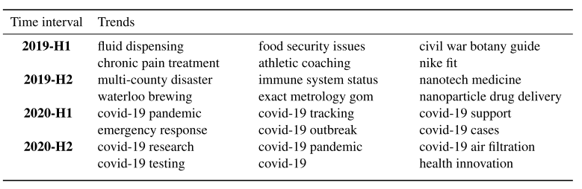
Trending articles and phrases
Trend phrase evolution of cluster 1
Notes:
So For getting a detailed understanding of result lets check the trending keywords related to these top clusters
…..The next table shows how our previous boomin cluster 1 evolove over time.
At beginin general health care phrases like food, pain and immune system, but then by 2020 it becomes about COVID which explains why the cluster had grown in trend in our previous chart.
We can also se the gradual shift in trends, like in 2020H1 it was covid pandemic and tracking but in 2020 H2 trends like testing and air filteration also pops up

Slide 19
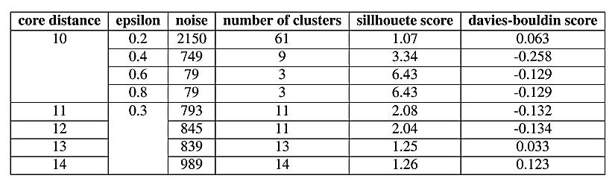
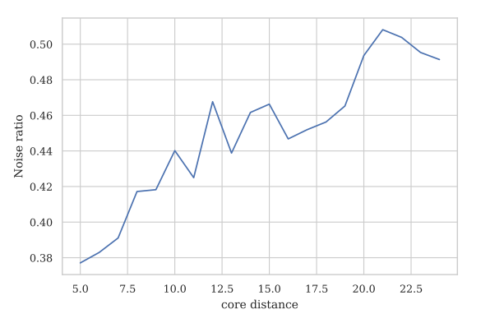
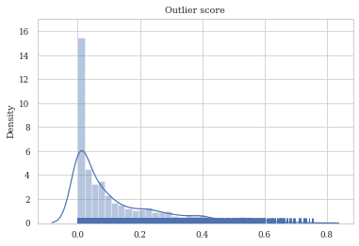
Evaluation metrics
Variation in noise ratio to core distance
Outlier score distribution
Notes:
Unsupervised learning so intrinsic measures like sillhote and davies bouldin index are used.
intrinsic measures doesn’t always give a good metric for cluster quality. These metrics give high score for configurations with less number of clusters, so if we merge all clusters and toatal num clusters are say 3, it gives better score than 20 clsuters. Which does not reflect the actual cluster quality
So other indications such as # cluster and noise ratio were also used for optimal hyper parameter tuning.
……Figure shows how the noise ratio changes with core distance in clustering. The larger the value of core dist you provide, the more conservative the clustering is ie more points will be declared as noise, and clusters will be restricted to progressively more dense areas. and the wedge at which were it produces min noise was selected.
…..The confidence of HDBSCAN algorithm in assigning clusters can be evaluated using outlier score. Figure shows the distribution of outlier score in the experiment. Looking at the distribution, more than 80% of articels were clustered with high confidence.
-------------
all score s low for these indexes, this is because noise points were also used
Sill high the beeter 1- (-1)
Davies . The minimum score is zero, with lower values indicating better clustering.
Otlier score: lower means high confidense

Slide 20
Limitations
Input token limitation on max 512
Ratio of articles that are classified as noise
Summary
Leveraging pre trained models and fine tuning them for semantic understanding
Trending topics were extracted by considering both the spatial and temporal properties of the dataset
Future research
Dynamic topic modeling
Fine tuning with domain corpora
Track topic drift/ topic split
Notes:
…..Now lets discuss some Limitation of the proposed framework
Firstly it has token limit cap of transformer model: ie 512 token max. So input seq has to be within this limit. Which is also a reason why I used title only. Though its possible to use full article and use some pooling in average or mean pooling
Another draw back is the number of points classified as Noise. Noise and cluster size goes hand in hand, either we get large cluster and less noise or vice versa. Also the possibility that this noise can refer to emerging trends that is in growing phase and has not enough articels to identify them has individual clusters.
….. Summary of the proposed framework
- The framework leveraged the knowledge from pretrained models and fine tuning the model with domain task for optimal performance. And was able to create a high quality embeddings for articels.
- proposed framework was able to extract topic both with spatial and temporal properties and track topic growth in a completely unsupervised manner.
…..The algorithm can still be improved in many ways. Some of the directions for future work are
Design the framework to be able to handle stream of incoming news which makes it scalable.
Fine tuhning with tech news corpora (current dataset contains generic news and not specific to tech news, it misses lot of tech vocabularies and relations- like tesla and spaceX)
Model clusters in sucha away to track topic drift or maybe topic splits in real time.

Slide 21
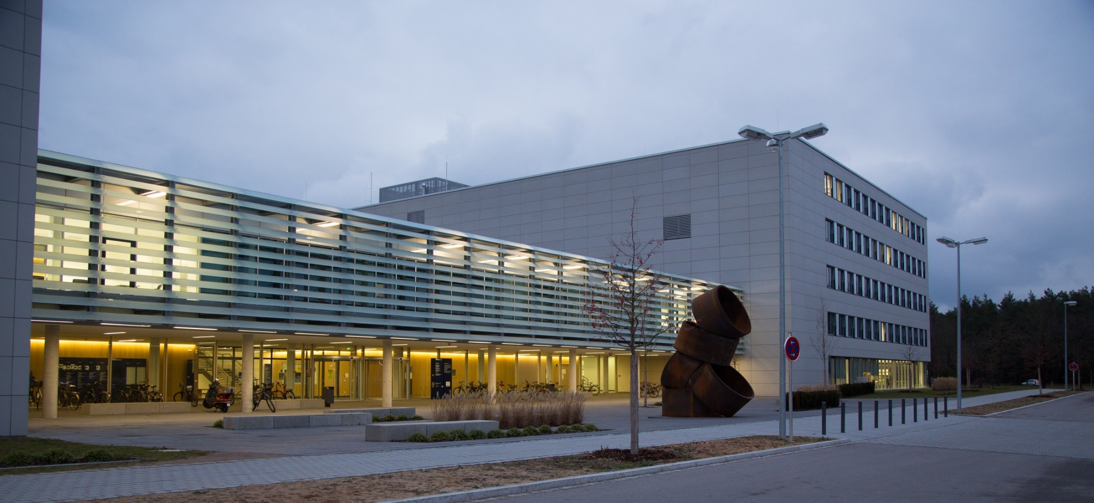
Thank you
Notes:
So that’s it, and I hope everybody enjoyed my talk.

Slide 22
Notes:
How cluster 1 trediness evolove over time

Slide 23
Dataset
dataset
Vectorizing
FE
clustering
keywords
TITLE | TEXT | DATE | URL | …
MicroLED display optimizes AR viewing | Plessey has added passive- matrix microLED displays to its Data- Vu segmented microLED family based on the company’s monolithic GaN… | 2020-04-01 | https://www.edn.com/microled-display
Why language technology can’t handle Game of Thrones | Researchers from the Vrije Universiteit Amsterdam and the Dutch Royal Academy’s Humanities Cluster evaluated four state-of-the-art tools for recognizing names in text… | 2019-04-18 | https://www.sciencedaily.com/releases/2019/04/190418080816.htm
Material Chemists Demonstrate Potential to Produce Sustainable Fabrics from Fungi | An international research team, under the guidance of material chemists Alexander Bismarck and Mitchell Jones from the University of Vienna… | 2020-09-08 | https://www.sciencedaily.com/releases/2020/09/200907112331.htm

Slide 24
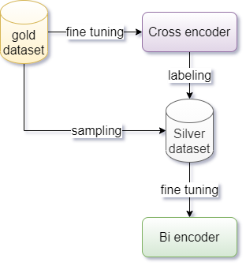
Fine tuning
Bi encoder Training parameters
batch_size = 16
num_epochs = 1
max_seq_length = 128
Notes:
What are the major findings and what do they mean with regard to your research
How do these findings relate to what others have found in the past
How can you explain any unusual or surprising result

Slide 25
HDBSCAN
Transform the space according to the density/sparsity. (Weighted graph using mutual reachability distance)
Build the minimum spanning tree of the distance weighted graph.
Construct a cluster hierarchy of connected components.
Condense the cluster hierarchy based on minimum cluster size.
Extract the stable clusters from the condensed tree.

Slide 26
Trend detection
Time series analysis: articles are then aggregated to a fixed size time interval
Semantic search: indexed data for fast search
Time-interval = 2 weeks
Index algorithm = FAISS¹ library
Notes:
All results are combined to dataframe n
- converted to time series by bining to time interval
Indexed for fast search
Interval-2w can be tweaked according to need
FAISS to any othe hashing can also be used
---
Cluster info stored as DF using a multi index- based on time-interval

Slide 27
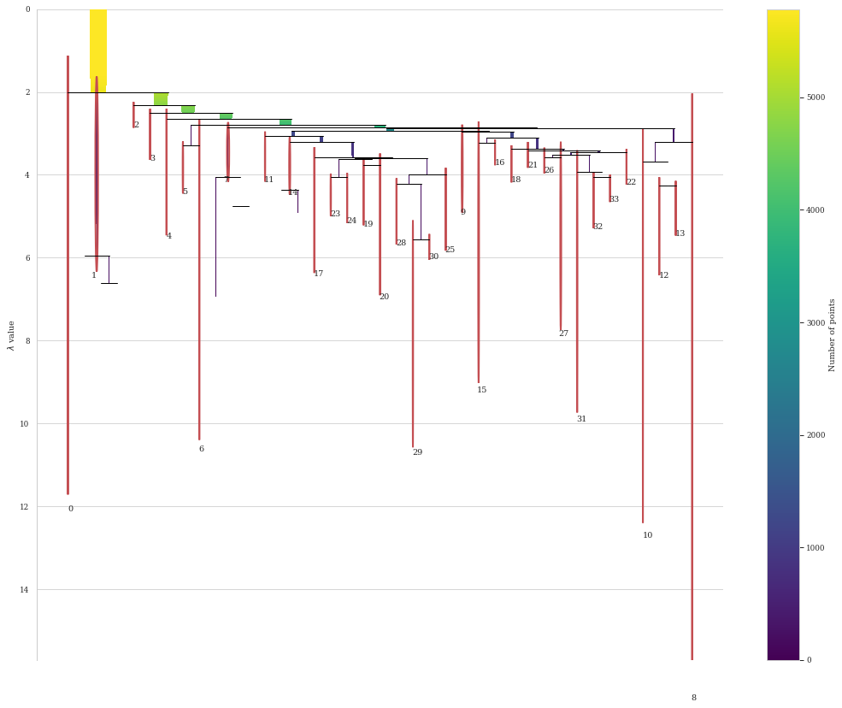

Slide 28
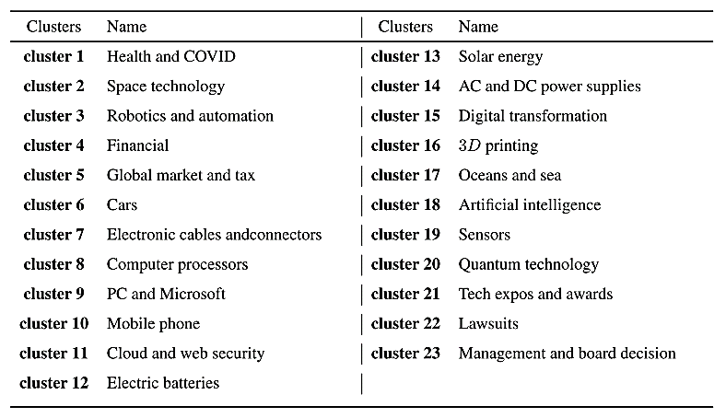
All clusters
Notes:
These are the result from clustering and manually labeled topics.
The clustering is robust and coherent withn each cluster.
A deeper analysis gives..

Slide 29
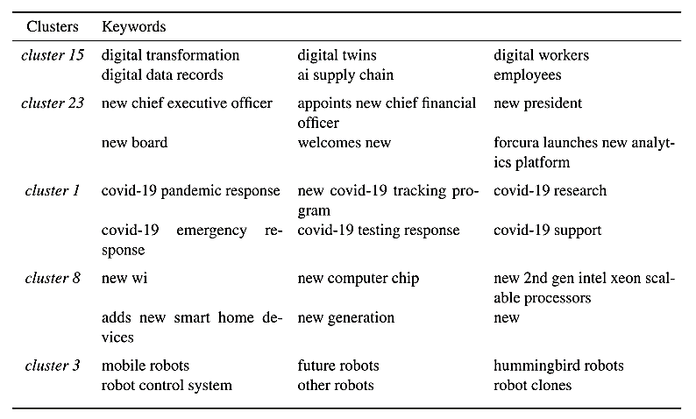
Trend phrase analysis of top clusters
Notes:
So For getting a detailed understanding of result lets check the trending keywords related to these top clusters
Table shows high ranked phrases from keyword extraction.
What I learned was High ranked phrases in each cluster are general in nature and mid ranked ones are more specific.

Slide 30
Low score Trends
Cluster 1: Covid
COVID-19 Health Messaging Campaign (low score)
Post-COVID-19 EV Market
April 14 mobile COVID-19 testing
the Mexican Government COVID-19 Order
Remote Patient Monitoring
Cluster 20: Quantum tech
New quantum material
IoT systems
New smart health sensor
(low) Broadening room sensor enclosure solutions
particulate matter sensors
quantum information systems
CMOS Image Sensors

Slide 31
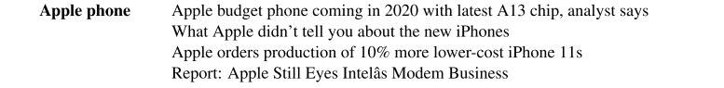
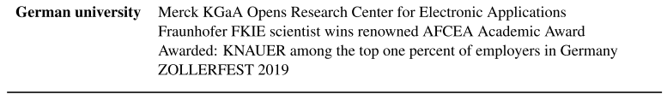
Custom phrase search
We first have used UMAP for isolating manifolds and projecting them into a lower-dimensional space. We then used HDBSCAN for discovering the high-density areas in the UMAP space.
Notes:
How cluster 1 trediness evolove over time

Slide 32
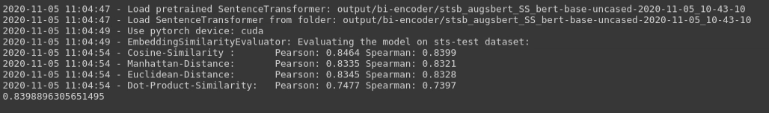
Notes:
How cluster 1 trediness evolove over time

Slide 33
Sillhouete score
empirical method measuring the consistency of the clusters by comparing how much a point is similar to its cluster (cohesion) compared to the other clusters (separation). The silhouette ranges from −1 to +1, where a high value indicates that the object is well matched to its own cluster and poorly matched to neighboring clusters.

Slide 34
n_neighbors - the number of approximate nearest neighbors used to construct the initial high-dimensional graph. It effectively controls how UMAP balances local versus global structure
min_dist, or the minimum distance between points in low-dimensional space. This parameter controls how tightly UMAP clumps points together, with low values leading to more tightly packed embeddings.
Notes:
How cluster 1 trediness evolove over time

Slide 36

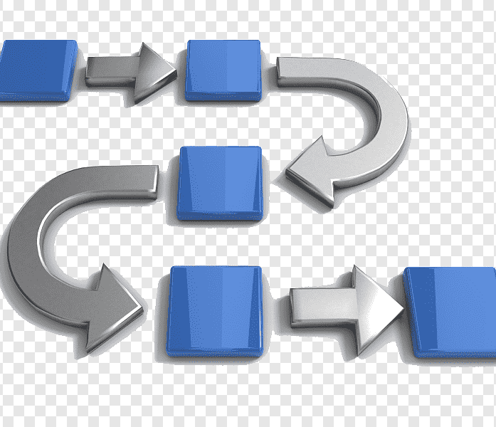

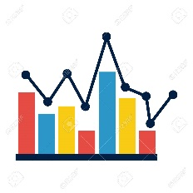
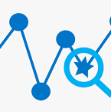
Thesis Pipeline: INTRO TALK !!!
Data ingestion
Data cleaning
Topic identification
Distribution over time
Topic Forcasting

Slide 37




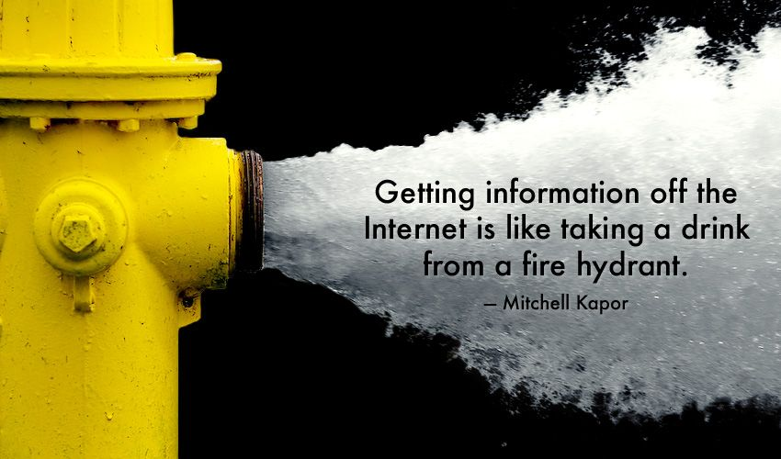
Motivation
Notes:
Big data nd how its shifting rapidly
NOKIA staying upto date is important
We all have been in that situation where we want information on something from internet. Sometimes we find the information directly, sometimes we might have to sort things, sometimes it’s just overwhelming. And we lose our interest.

Slide 38
Timeline
June | July | August | September | Oktober | November
Preprocessing
Keyword Extraction
Topic Modelling
Anomaly Detection

Slide 39
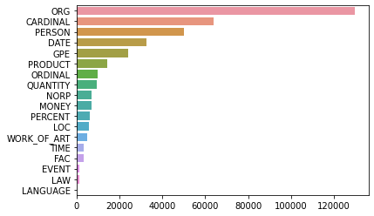
NER on text
Person! 3rd interesting

Slide 40
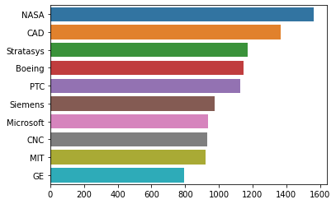
Top 10 organizations

Slide 41
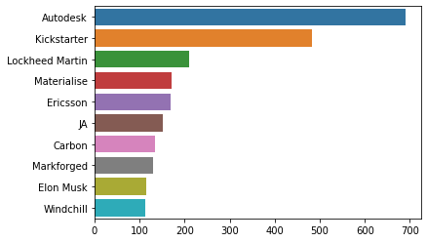
Top 10 persons

Slide 42
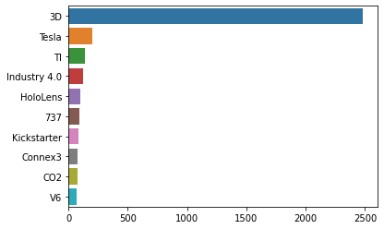
Top 10 products

